Slide 1

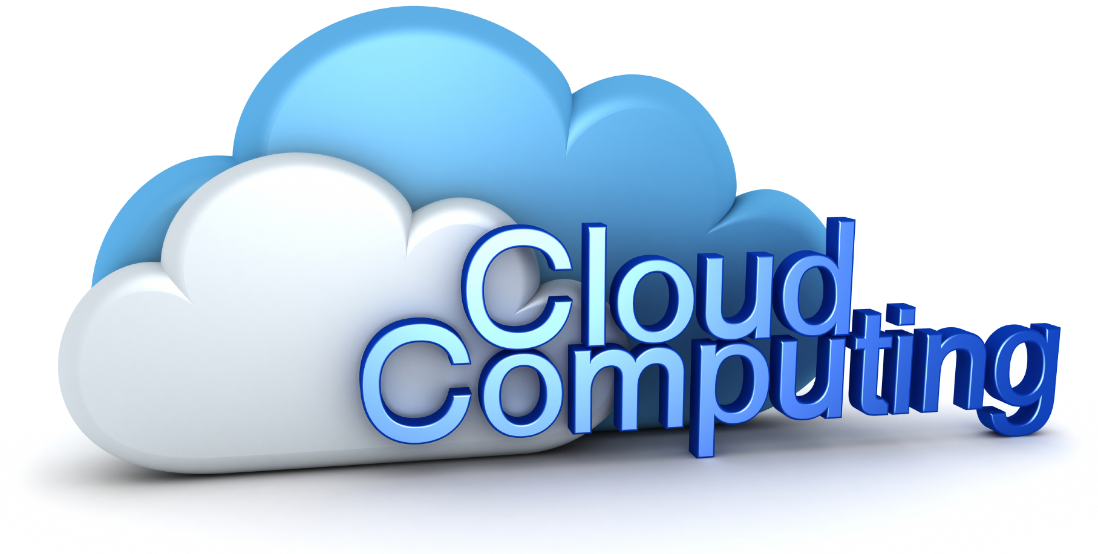

Name: Karthikeya Thanniru
Section: IMCA Y5
Year: 3rd
Date: 2nd December 2021

Slide 2
Agenda
01
02
03
Founder of Cloud
Road Map
BIG Three – CSP’s
04
05
06
Cloud Computing
History
Advantages
07
08
09
Models
Deployments
Jobs related to Cloud domain
SAAS,PAAS,IAAS
Public, Private, Hybrid

Slide 3
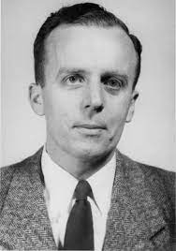
FOUNDER OF CLOUD COMPUTING:
Joseph Carl Robnett Licklider
He was Born in March11,1915 in St.Louis,Missouri,USA
He is a American Computer Scientist and Pyschologist
He was invented Cloud computing in 1960’s with his work on Advanced Research Projects Agency Network (ARPANET)
In 1966 he enabled the ARPANET project to access to remote computers

Slide 4
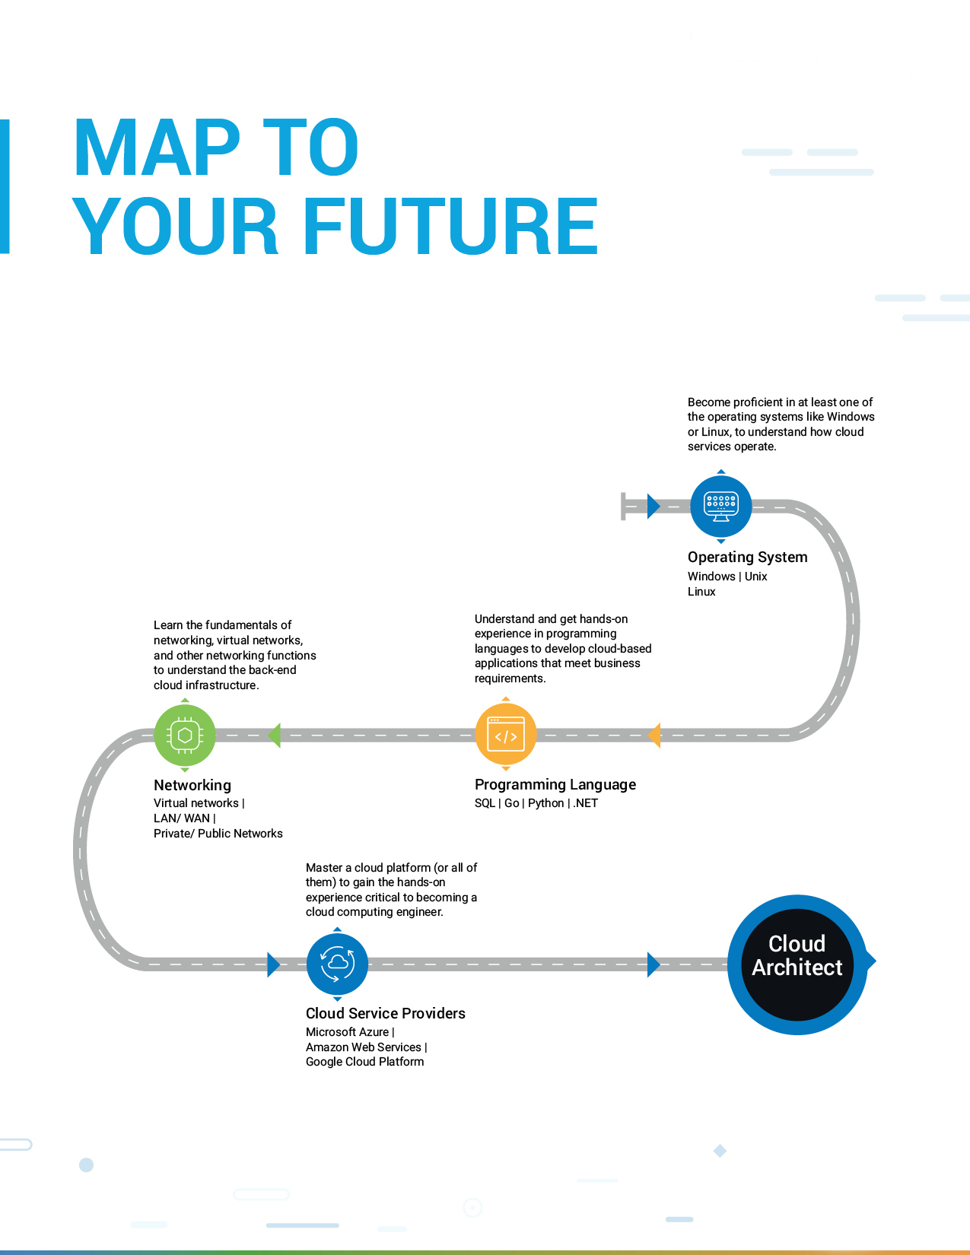
Road Map

Slide 5
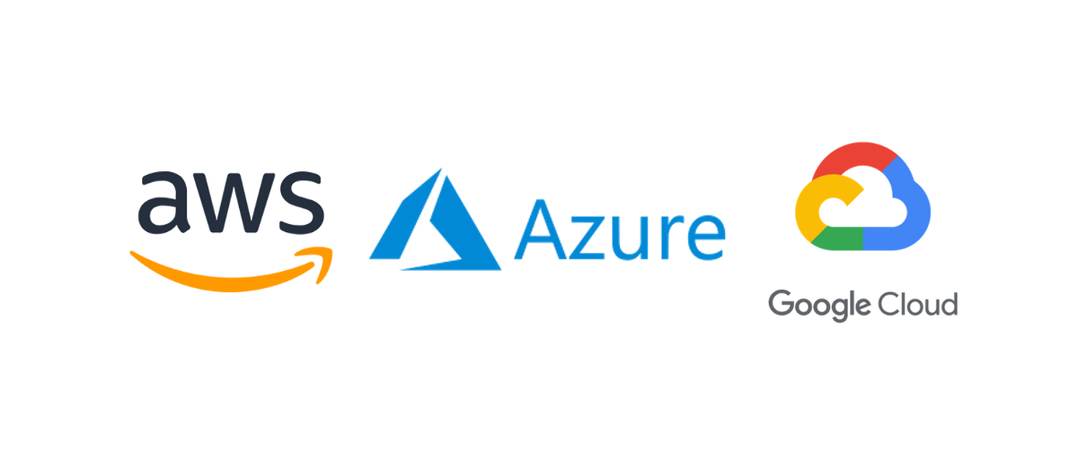
BIG Three – CSP’s
Amazon Web Services - AWS
Microsoft Azure - Azure
Google Cloud - GCP

Slide 6

THE CLOUD
#INTERNET
Internet: - Is a worldwide network were Billions and billions of devices such as computers, servers, cell phones, Tablets etc..
As long as they are connected using global network any computer can communicate with any other computer.
Thanks to the Internet.
CLOUD = INTERNET
INTERNET = Global Network of connected devices

Slide 7


CLOUD COMPUTING
#ON-Demand delivery of Compute, Database Storage, applications and other IT resources.
Instantaneous access to computational, storage, software using Internet.
When you want it, where you want it
More Flexibility

Slide 8
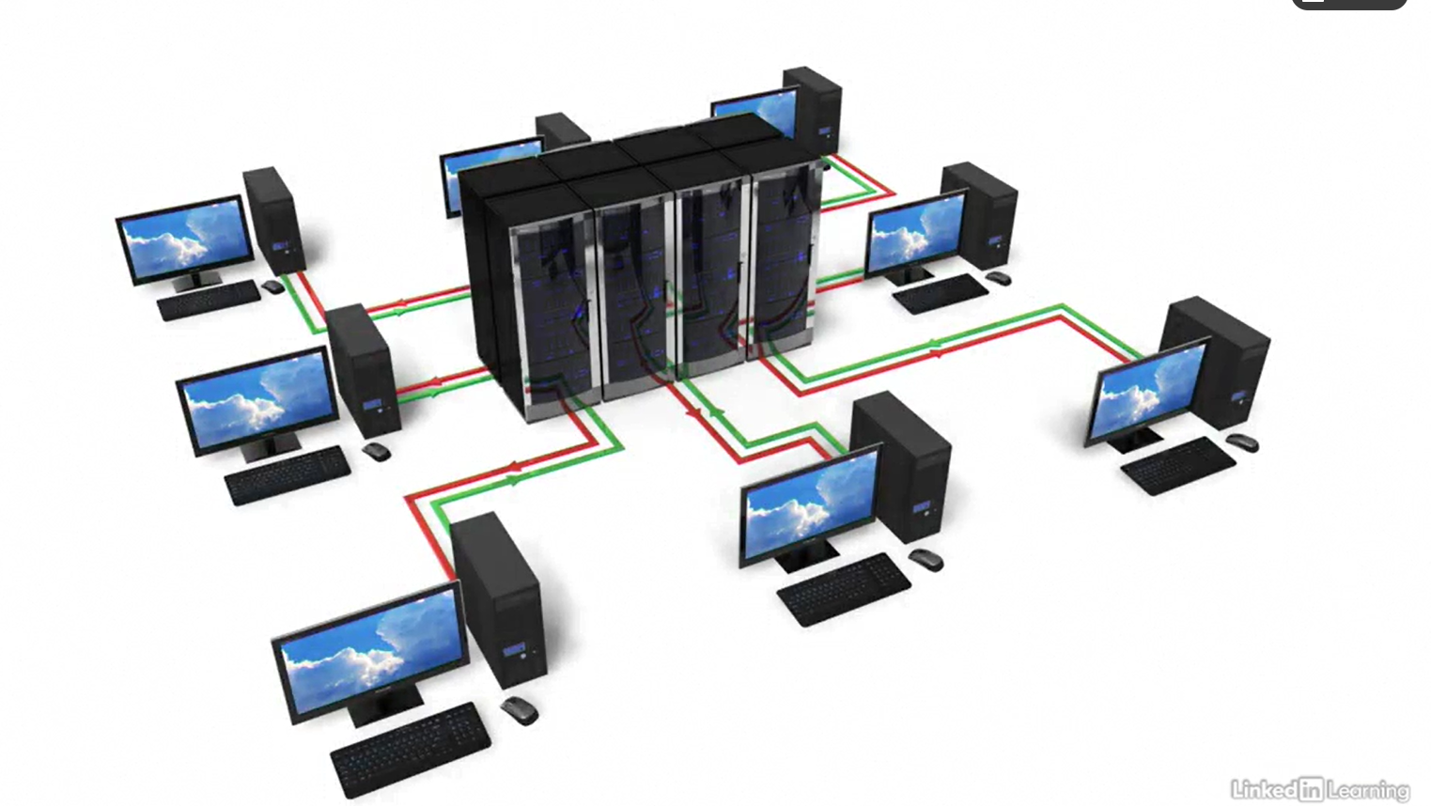
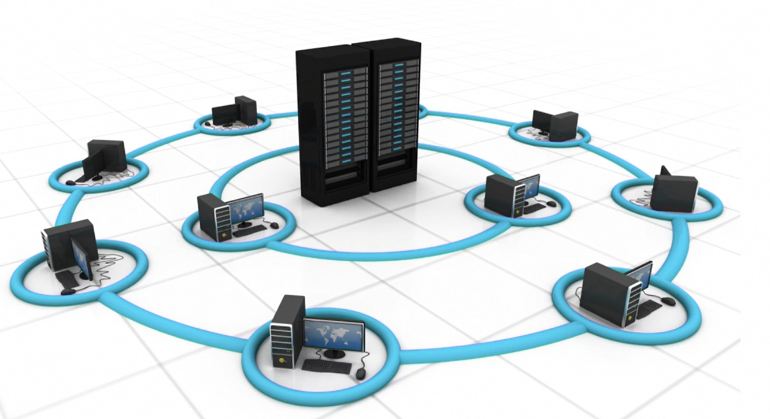
HISTORY
Way back to 1950’s # Mainframe Computing
Central computer accessed by Numerous devices.
Central has all compute capabilities
Devices will send requests to Mainframe
computer are called dumb terminals.

Slide 9
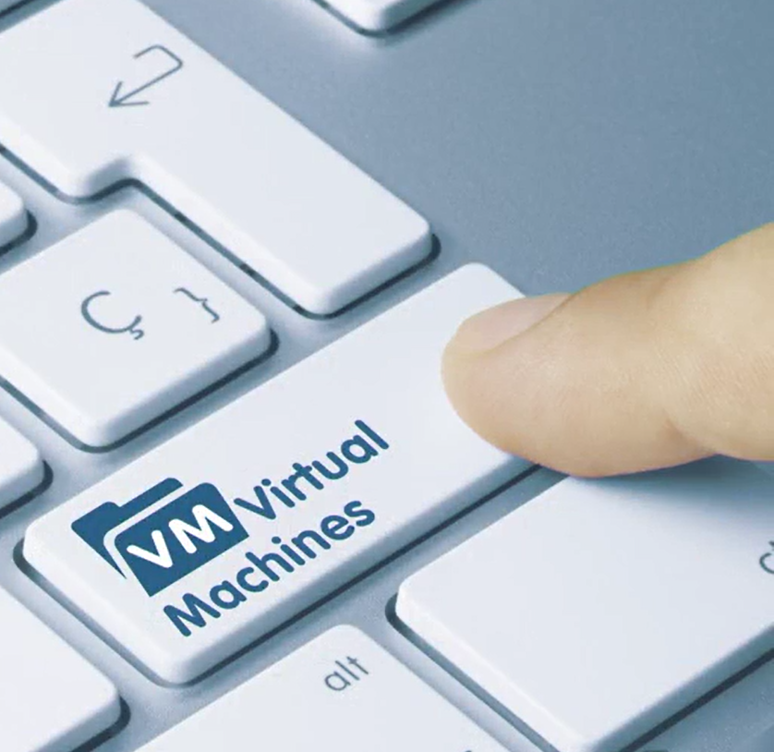
HISTORY
Way back to 1970’s # Virtual Machines
Multiple operating systems live in a single piece of Hardware.
One single Mainframe Computer can run multiple operating systems running at same time and do many different things.

Slide 10
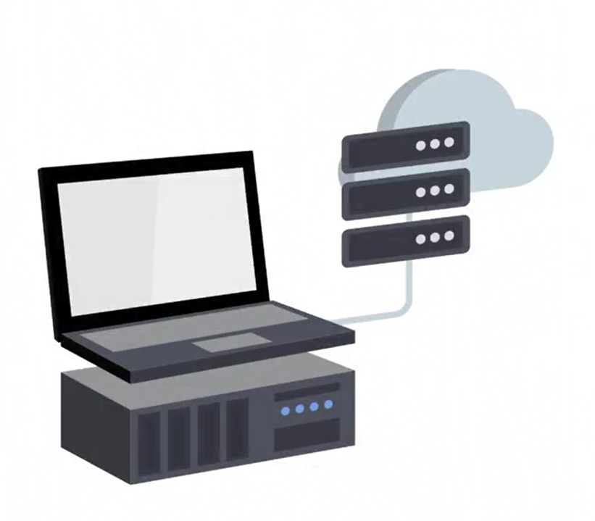
HISTORY
Way back to 1970’s # Hypervisor
Lot of Mainframe computers resources.
Beginning of Modern concept of Cloud computing.
Software that links multiple hardware's to use as one giant resource.
Programs will run super fast, analyze data at blazing speed.

Slide 11
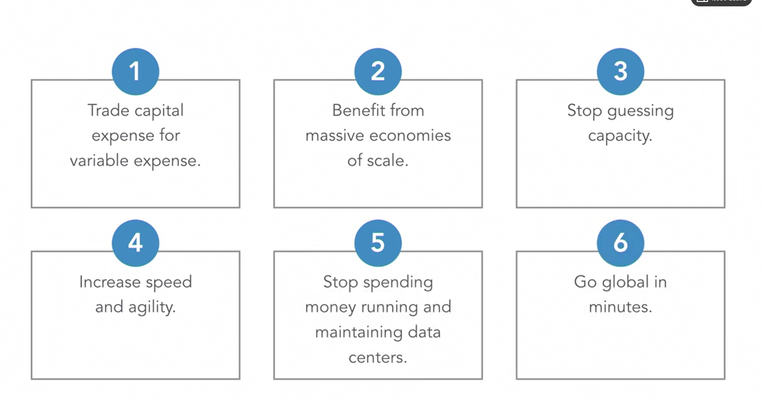
ADVANTAGES
No need of physical servers or cabling
No need for server room setup or Maintenance
No hardware replacement or procurement
Pay only when what you consume
Scale up or down instantaneously

Slide 12
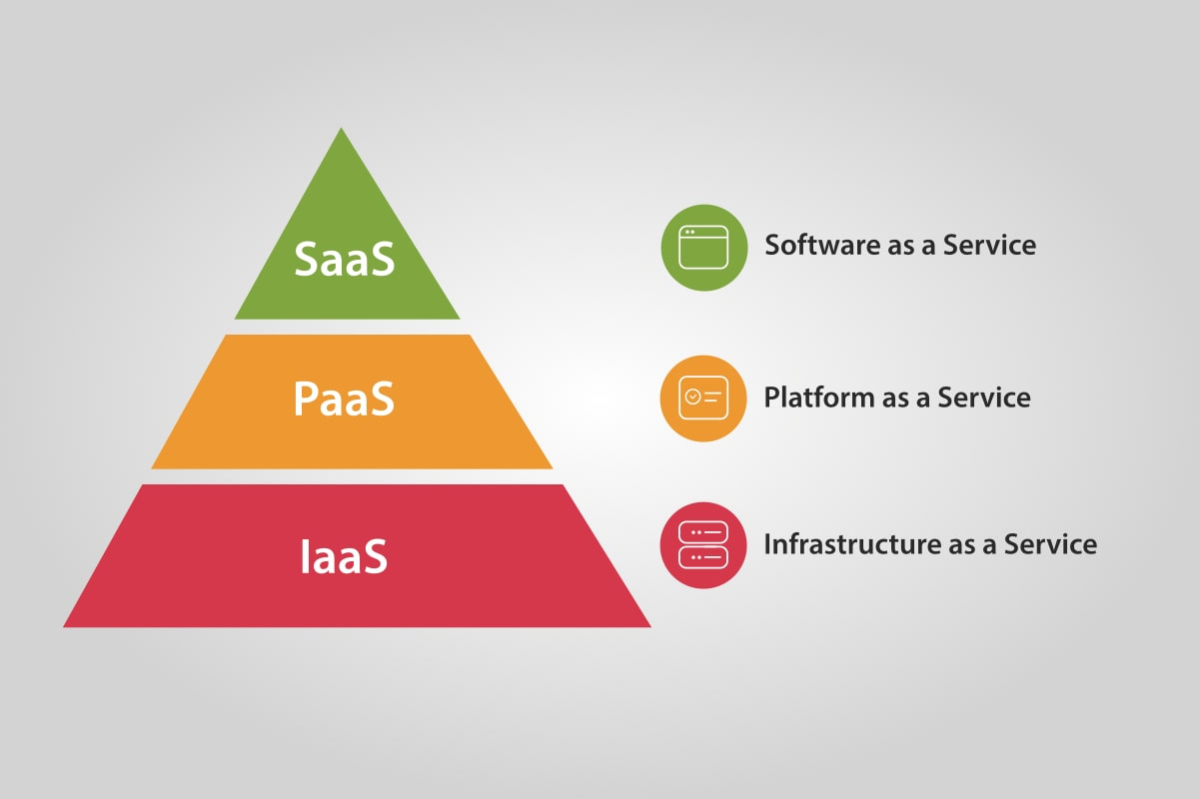
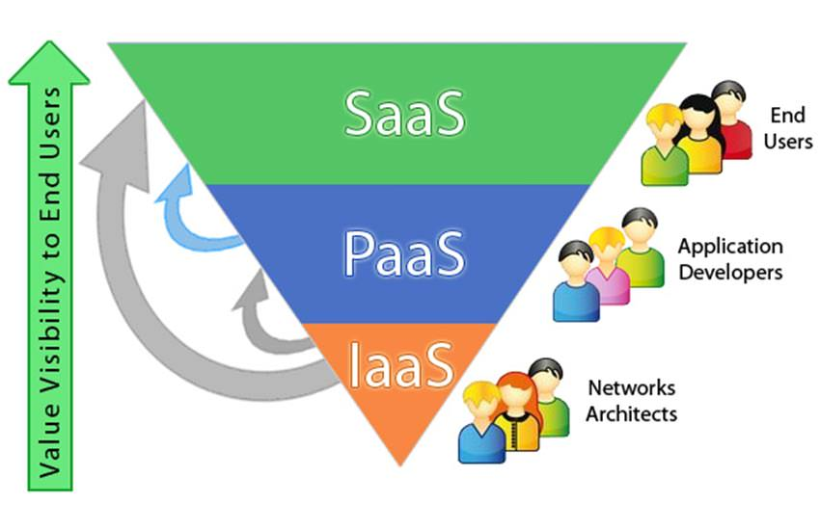
MODELS

Slide 13
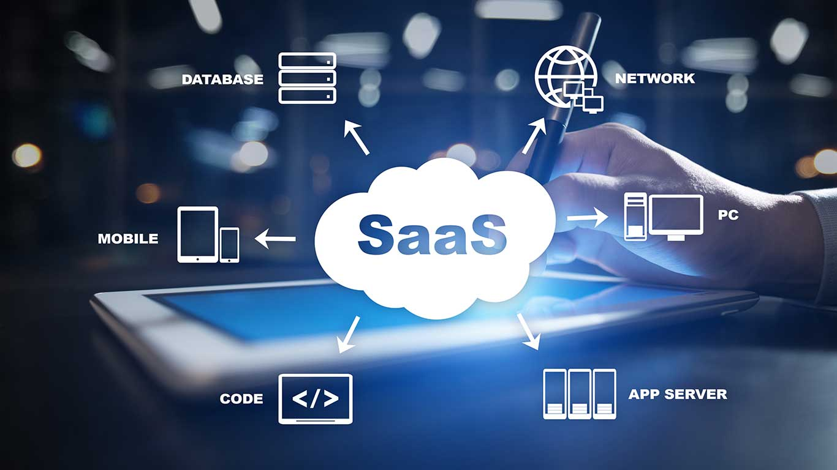
SAAS (Software as a service)
Completed products managed by Service provider.
Get whole package of the service.
Easy to use as end user
Cloud based email service such as Outlook, Gmail.
You only need to create an account to send and receive Emails.

Slide 14
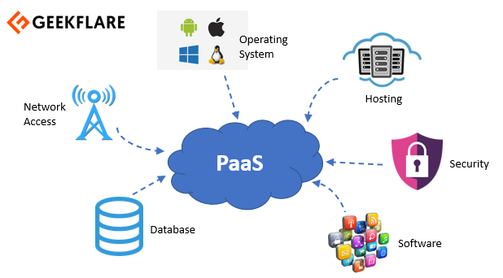
PAAS (Platform as a service)
Deploy and manage applications without worry about hardware infrastructure.
Service like webservers, databases, Operating systems to host applications.
Execute programming languages.
Microsoft Azure web hosting, Google App Engine, Heroku
Less Flexibility than IaaS as packages are preconstructed.

Slide 15
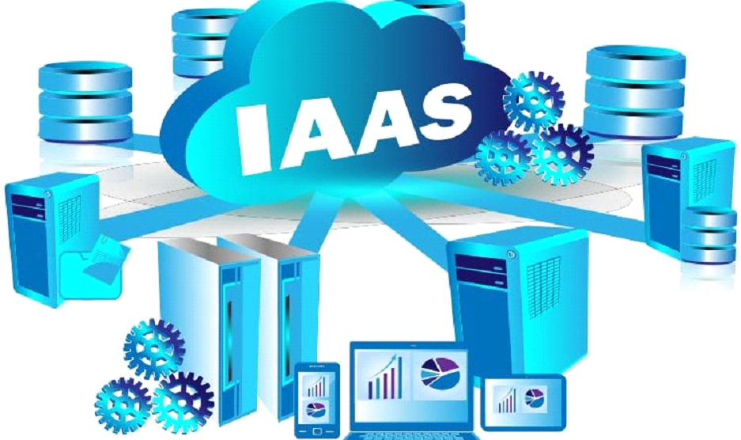
IAAS (Infrastructure as a service)
Basic Building blocks.
Have control over the network security, computers, servers
Most Flexible and management control.
Closest to have traditional on-premises data center
EX:- Amazon Web Services, Microsoft Azure, Google Cloud
Modify and control almost all parts of infrastructure in the cloud.
No need to purchase or manage actual Hardware.

Slide 16
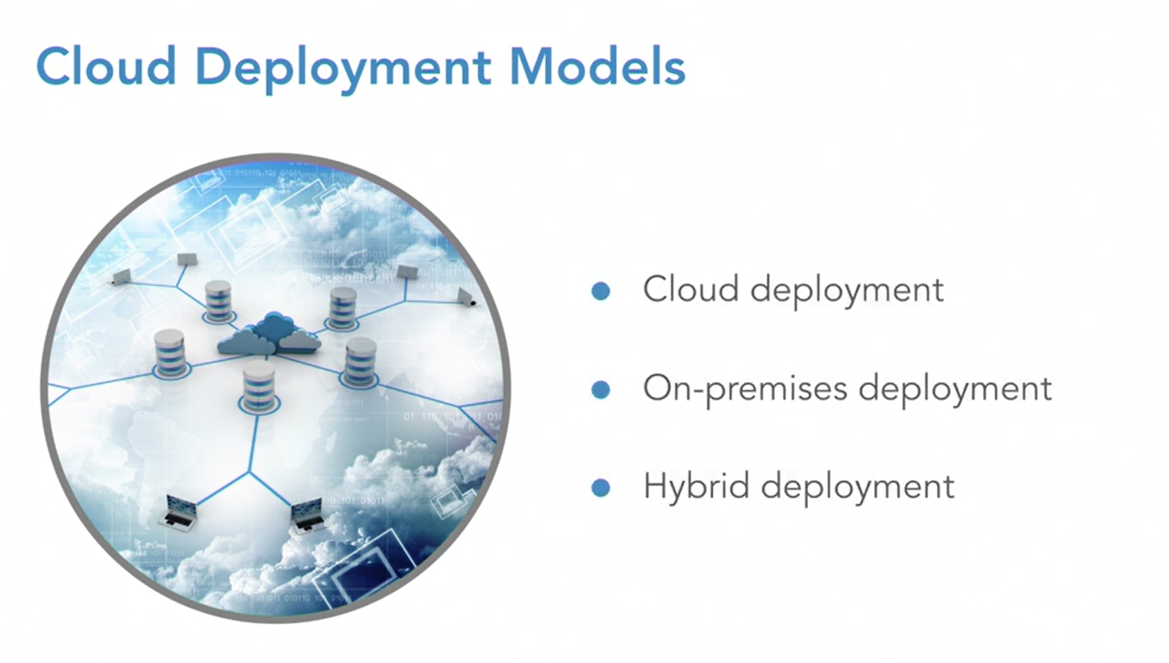
DEPLOYMENT MODELS

Slide 17
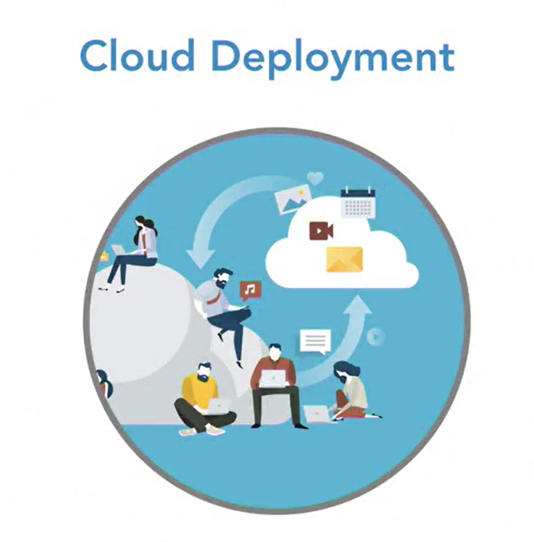
CLOUD DEPLOYMENT
100% IT Infrastructure on the cloud.
All applications migrated or created in the cloud.
Most Flexible and Scalable.
Removes roadblock of costly and time-consuming procurement process.

Slide 18
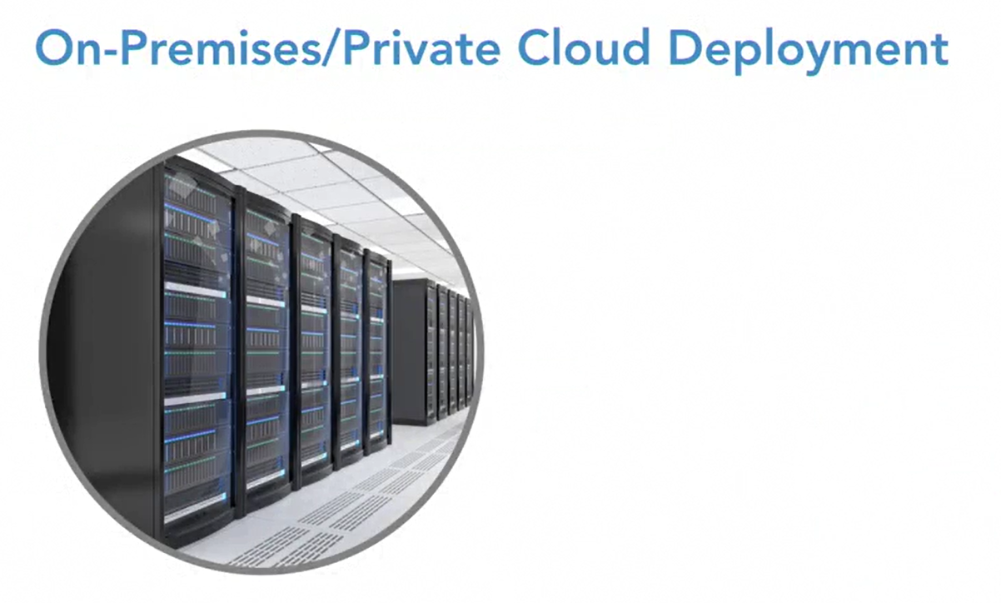
ON- PREMISES DEPLOYMENT
Use virtualization to deploy resources in their on-premises data centers.
Often looks like traditional IT Infrastructure.
Does not provide lot of benefits in cloud computing.
Resources are not shared to any other organizations.

Slide 19
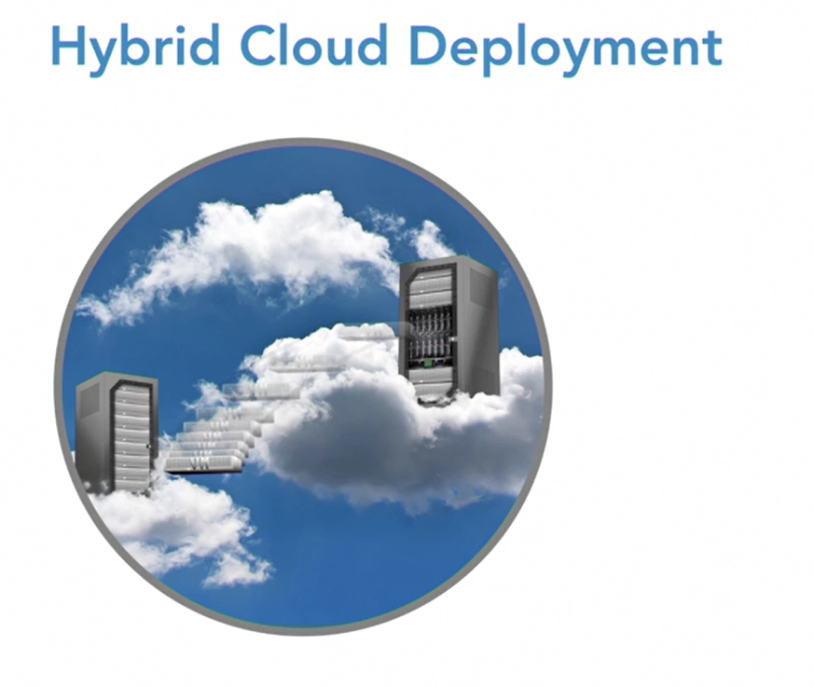
HYBRID DEPLOYMENT
Connects on-premises technology with cloud-based resources.
Great for most of the companies migrating over to the cloud
Data partially on the cloud and partially on-premises data center.
Backup and disaster recovery solution

Slide 20

Jobs Related to Cloud Computing :
Cloud administrator
Cloud architect
Cloud automation engineer
Cloud consultant
Cloud engineer
Cloud security analyst
Cloud software engineer

Slide 21
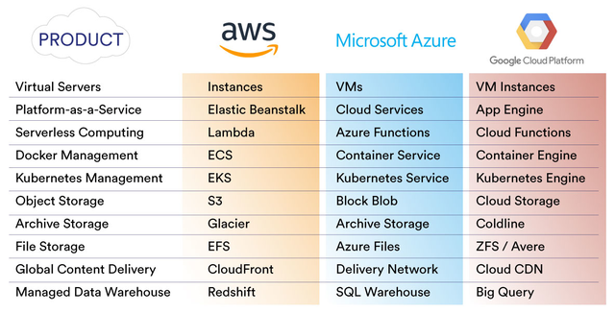

Slide 22
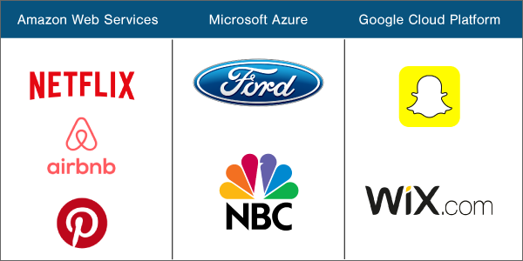

Slide 23
References
https://www.sanfoundry.com/best-reference-books-cloud-computing/
https://www.easyexamnotes.com/p/cloud-computing-reference-model_31.html
https://www.researchgate.net/publication/323902486_Cloud_Computing_Reference_Architecture_from_Different_Vendor's_Perspective
https://ieeexplore.ieee.org/document/6149278

Slide 24
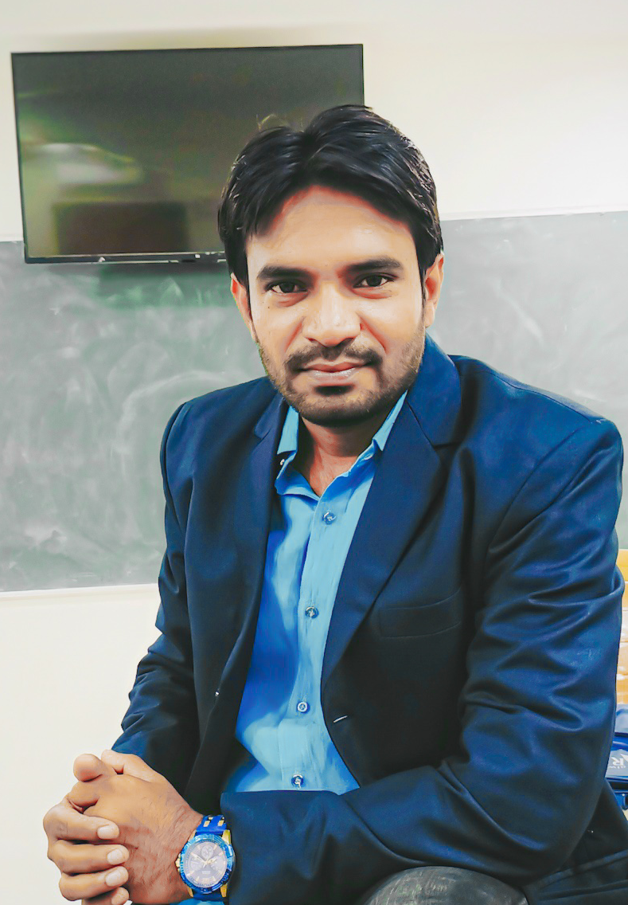
Thank you
Mamjan Shawali sir, Sr.Lecturer, KCDC, Nellore

Slide 25


